Slide 1
SMART IRRIGATION SYSTEM
S.CHINNARI
T.SANTHI
CH.ANUSHA
CH.SUMEDHA
P.ALEKHYA

Slide 2
INTRODUCTION
This smart irrigation system senses the moisture content of the soil and automatically switches the motor when the power is on.
A proper usage of irrigation system is very important because the main reason is the shortage of land reserved water due to lack of rain , unplanned use of water . As a result large amount of water waste . For this reason we use this system and is used in all climatic conditions.

Slide 3
COMPONENTS
ESP32
SOIL MOISTURE SENSOR
TEMPERATURE SENSOR(LM35)
AIR QUALITY SENSOR
DC MOTOR
LCD( 16x2 display)
HUMIDITY SENSOR

Slide 4
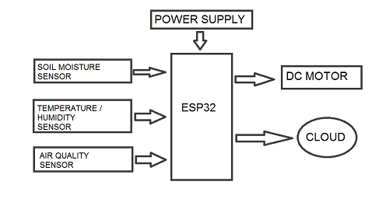
BLOCK DIAGRAM

Slide 5
WORKING
The block diagram of the smart irrigation system comprises 3 main components , namely microcontroller(ESP32) , a motor driver circuit and a sensor circuit.
When the sensor circuit senses the condition of soil , it compares it with the reference value . when the soil condition is less than the reference value , then the soil is considered as dry and logic-1 is send to the microcontroller . microcontroller then turns on the motor driver circuit and prompts the motor to pump water to the soil.
When the soil condition is more than the reference value , then the soil is considered as wet and logic-0 is send to the microcontroller . The microcontroller then turns off the motor .

Slide 6
CONCLUSION
A step-by-step approach in designing the microcontroller basic system for measurement and control of three essential parameters for plant growth , that is temperature , soil moisture , air quality has been followed.
This system reduces the power consumption , maintenance and complexity ,at the same time providing a flexible and precise form of maintaining the environment.

Slide 7
FUTURE EXTENSION
A multi controller system can be developed that will enable a master controller along with its slave controllers to automate multiple greenhouses simultaneously.
The device can be made to perform better by providing the power supply with the help of solars , to reduce the requirement of main ac power.

Slide 8


